Slide 1
Module 6 Meraki

Slide 2
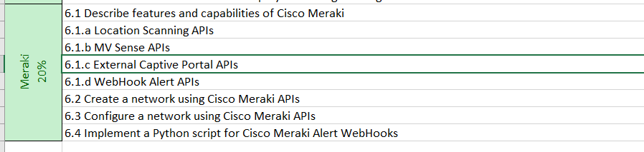
Agenda

Slide 3
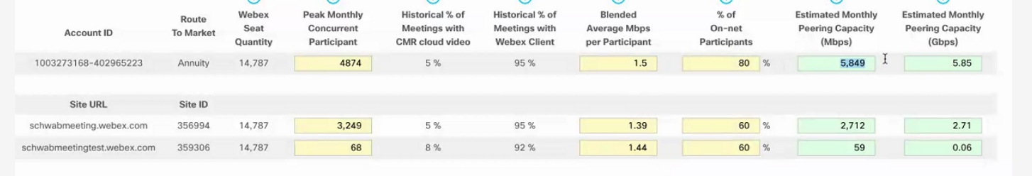
Resources
Should the Peak montly concurrent equal the sum of schwabmeeting + schwabmeetingtest? Why is it higher?
Shouldn’t these be similar? Is it 60 or 80? And why is blended average higher

Slide 4
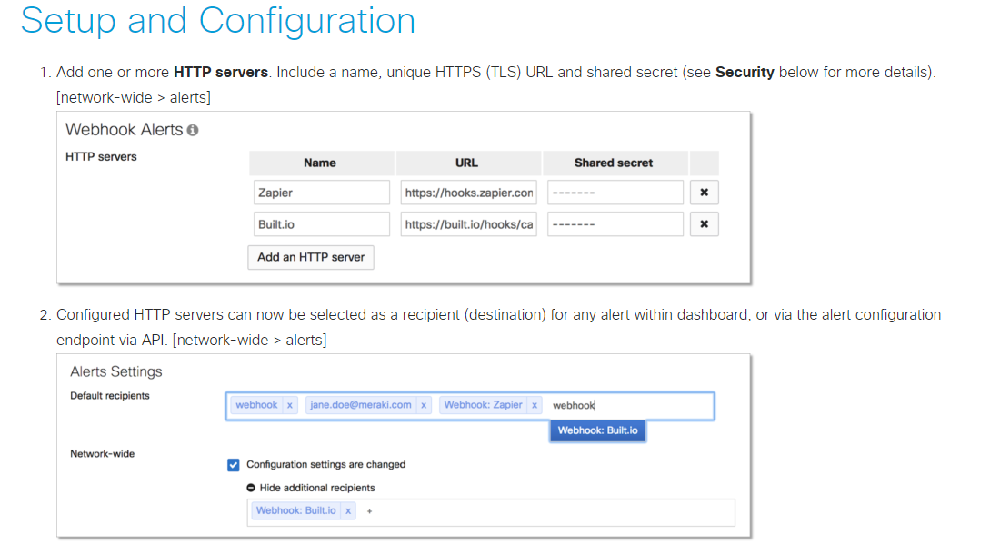
Webhooks
Example data : (Good to investigate what webhooks look like)
https://documenter.getpostman.com/view/897512/SVfRtnU7?version=latest

